Slide 1


LESSON 2
TRIGONOMETRY OF RIGHT TRIANGLES

Slide 2


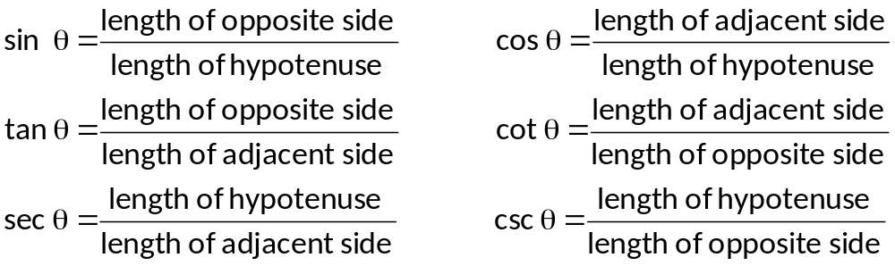
THE SIX TRIGONOMETRIC FUNCTIONS
hypotenuse
hypotenuse
Opposite
side
Adjacent
side
Adjacent
side
Opposite
side
Let θ be an acute angle of a right triangle. The values of the six trigonometric functions of θ are

Slide 3
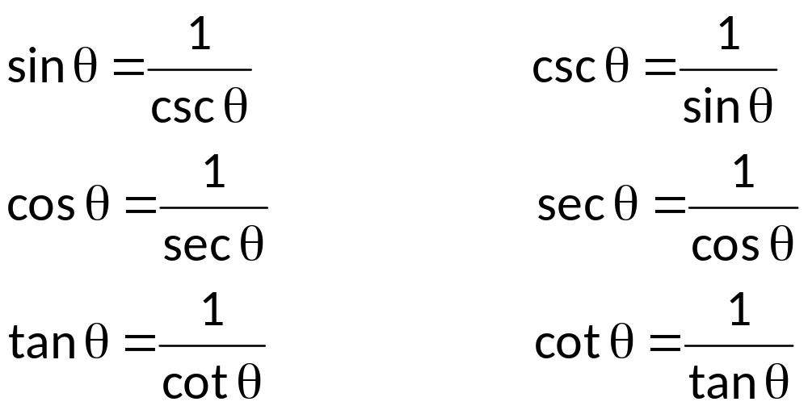
RECIPROCAL FUNCTIONS
The following gives the reciprocal relations of the six trigonometric functions:

Slide 4
PYTHAGOREAN THEOREM
The Pythagorean Theorem states that the square of the hypotenuse is equal to the sum of the squares of the other two sides. Referring to the right triangle below, then
c² = a² + b²
The Pythagorean Theorem is used to find the side of a right triangle.
B
c
a
A
C
b

Slide 5






FUNCTIONS OF COMPLEMENTARY ANGLES
B
sin A =
sin B =
c
a
cos A =
cos B =
A
C
b
tan A =
tan B =
Comparing the trigonometric functions of the acute angles A and B, and making use of the fact that A and B are complementary angles (A + B = 90⁰), then
cot A =
cot B =
sec A =
sec B =
csc A =
csc B =

Slide 6
sin B = sin (90⁰ – A) =cos A
cos B = cos (90⁰ – A) = sin A
tan B = tan (90⁰ – A) = cot A
cot B = cot (90⁰ – A) = tan A
sec B = sec (90⁰ – A) = csc A
csc B = csc (90⁰ – A) = sec A
The relations may then be expressed by a single statement that: A trigonometric function of an angle is always equal to the co-function of the complement of the angle.

Slide 7

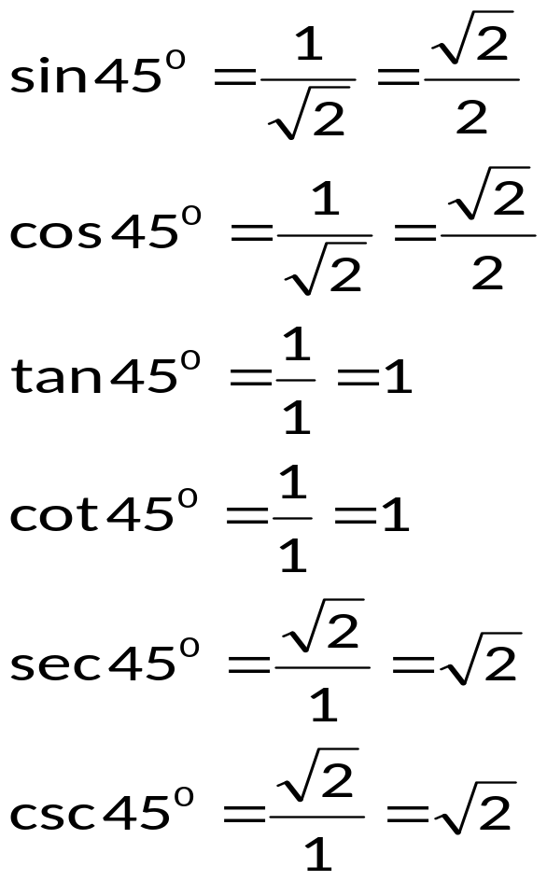

TRIGONOMETRIC FUNCTIONS OF SPECIAL ANGLES 45⁰, 30⁰ AND 60⁰
To find the functions of 45⁰, construct an isosceles right triangle with each leg equal to 1, that is a = 1 and b = 1. By Pythagorean Theorem, the hypotenuse c = .
45⁰
1
45⁰
1

Slide 8

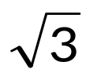
To find the functions of 30⁰ and 60⁰, take an equilateral of side 2 and draw the bisector of one of the angles. This bisector divides the triangle into two congruent right triangles whose angles are 30⁰ and 60⁰. By Pythagorean Theorem, the length of the altitude is .
30⁰
2
60⁰
1
Notes:
++

Slide 9
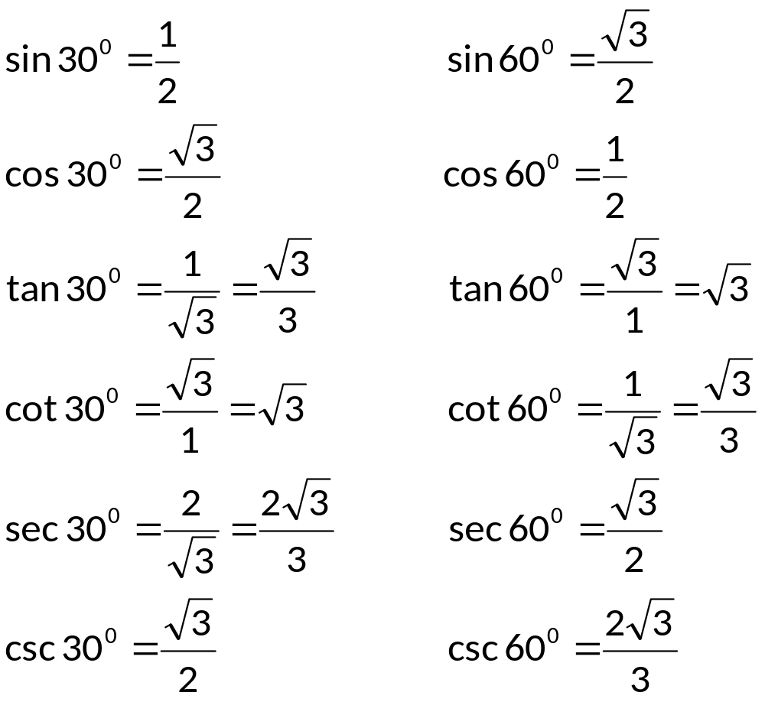

Slide 10
EXAMPLES
Find the values of the six trigonometric functions of θ for the right triangle with the given sides.
a)
b)
8
3
4
5

Slide 11
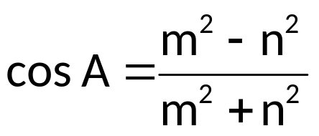
Given that θ is an acute angle and cos θ = 7/25, find
a) tan θ b) sin θ c) sec θ
Find the other five trigonometric functions of the acute angle A, given that:
a) sec A = 2 b)
Find the exact value of each expression.
a) csc 45⁰ – sec 45⁰
b) csc 60⁰ sec 30⁰ + cot 45⁰
c) cot²45⁰ + tan²60⁰ – sin²45⁰
d) csc (π/6) – sec (π/3)
e) cos (π/4) tan (π/6) + 2 tan (π/3)

Slide 12
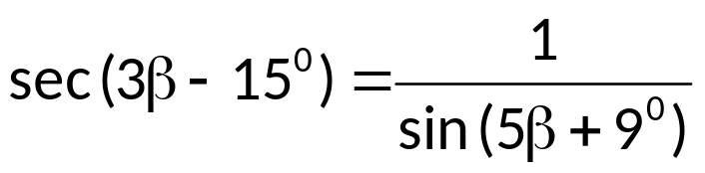
Express each of the following in terms of its cofunction.
a) cos 52⁰
b) sin (30⁰ + A)
c) tan 48⁰47’46”
Determine the value of β that will satisfy the following.
a) sin (4β + 10⁰) = cos 6β
b)

Slide 13
SOLUTION OF RIGHT TRIANGLE
To solve a right triangle means to find the measure of the three sides and three angles (one angle has a measure of 90⁰). The unknown parts of the triangle can be solved by using any of the following:
the definition of the trigonometric functions
the Pythagorean Theorem
the relations of complimentary angles

Slide 14
EXAMPLES
Solve each triangle ABC, in which C = 90⁰.
a) A = 32⁰ c = 12 ft.
b) a = 42 cm. b = 54 cm.
2. Consider the diagram below, determine the length FG.
G
F
40 cm.
15⁰
20⁰
E
D
100 cm.

Slide 15
A flagpole broken over by the strong wind forms a right triangle with the ground. If the angle which the broken part makes with the ground is 40⁰, and the distance from the tip of the flagpole is 45 feet. How tall was the pole?
At 3:00 P.M., a boat is 12.5 miles due west of radar station and traveling at 11 mph in a direction that is 57.3⁰ south of an east-west line. At what time will the boat be closest to the radar station?

Slide 16

ANGLE of ELEVATION and ANGLE of DEPRESSION
The angle of elevation of an object which is above the eye of an observer is the angle which the line of sight to the object makes with the horizontal. If the object is below the eye of the observer, the angle which the line of sight makes with the horizontal is the angle of depression of the object.
  Object
Line of sight
  Angle of Elevation
  Observer
  Horizontal
  Angle of Depression
Line of sight
  Object

Slide 17
EXAMPLES
The angle of elevation from a point 116 meters from the base of the Eiffel Tower to the top of the tower is 68.9⁰. find the approximate height of the tower.
The angle of depression to one side of a lake, measured from a balloon 2500 feet above the lake is 43⁰. The angle of depression from the opposite side is 27⁰. Find the width of the lake.
A building is 16 m from a television tower. From the top of the building, the angle of depression from the base 43⁰, and the angle of elevation to the top of the tower is 24⁰. Find the height of the tower.
The angle elevation from a point A to the top of the Washington Monument is 32⁰. From point B, which is on the same line but 55 feet closer to the monument, the angle elevation to the top is 38⁰. Find the height of the Washington Monument.

Slide 18
BEARING and COURSE
In navigation and surveying problems, there are two commonly used methods for specifying direction. The angular direction in which the craft is pointed is called the heading. Heading is expressed in terms of an angle measured clockwise from north.
The angular direction used to locate one object in relation to another object is called the bearing. Bearing is expressed in terms of the acute angle formed by a north-south line and the line of direction.

Slide 19
EXAMPLE
  Course readings of 75⁰, 150⁰ and 315⁰ are illustrated below with their corresponding bearing readings:
N
N
75⁰
N
315⁰
150⁰
S
S
N 75⁰ E
S 30⁰ E
N 45⁰ W
S

Slide 20
EXAMPLES
A boat is 25 miles due east of lighthouse A. Lighthouse B is 15 miles due south of lighthouse A. Find the bearing and distance of lighthouse B from the boat.
A plane flew 150 miles on a course of 220⁰ and then 130 miles on a course 130⁰. Then the plane returned to its starting point via the shortest route possible. Find that shortest distance.
The bearing from Puerto Princesa to Naga N 44⁰ E. The bearing from Naga to Zamboanga S 46⁰ E. A small plane traveling 65 miles per hour, takes 1 hour to go from Puerto Princesa to Naga and 2 hours to go from Naga to Zamboanga. Find the distance from Puerto Princesa to Zamboanga.

